Slide 1
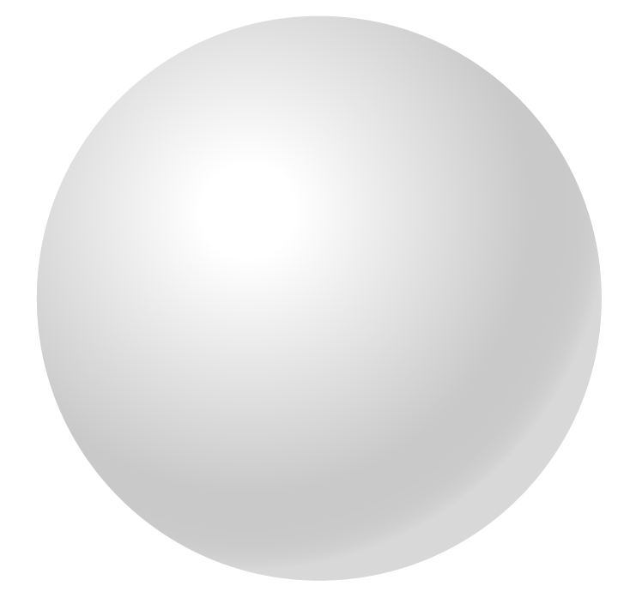

Healthcare Infographics
Step 01
Earth is the third planet from the Sun
Here is where this template begins
Step 02
Venus is the second planet from the Sun
This template has been created by Slidesgo

Slide 2
Healthcare infographics
Patient care journey
01
02
03
04
05
Symptoms
Diagnosis
Treatment
Follow-up
Recovery
Jupiter is the biggest planet of them all
Saturn is a gas giant and has several rings
Despite being red, Mars is actually a cold place
Earth is the third planet from the Sun and has life
Neptune is the eighth planet from the Sun
This template has been created by Slidesgo

Slide 3
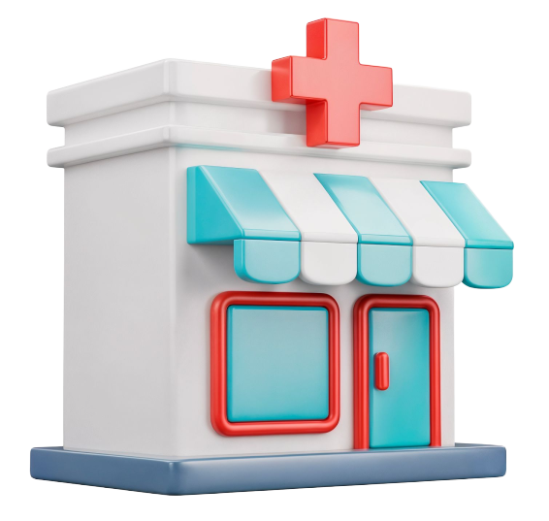
Healthcare infographics
Heart rate
Visual signs explained
1
How fast the heart beats
Blood pressure
2
Force of blood against artery walls
Body temperature
3
Body heat level
Respiratory rate
4
Breathing frequency
Oxygen saturation
5
Oxygen level in the blood
This template has been created by Slidesgo

Slide 4

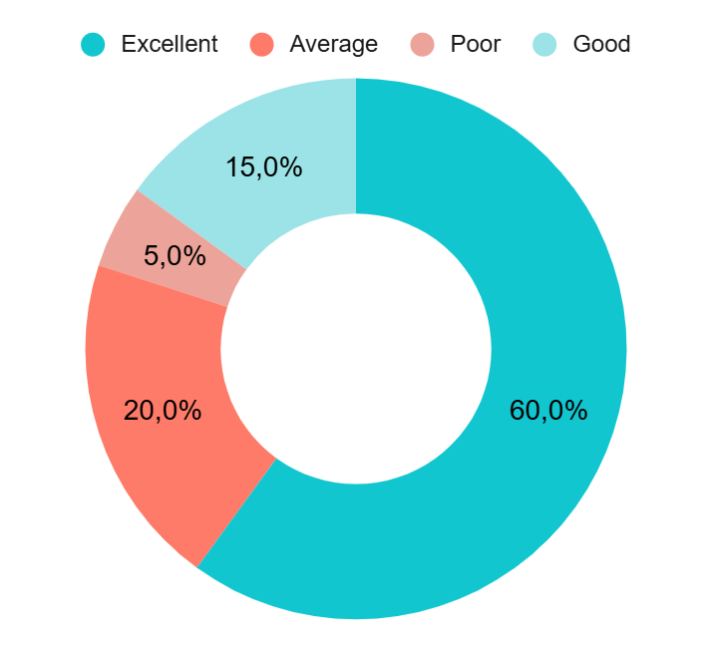
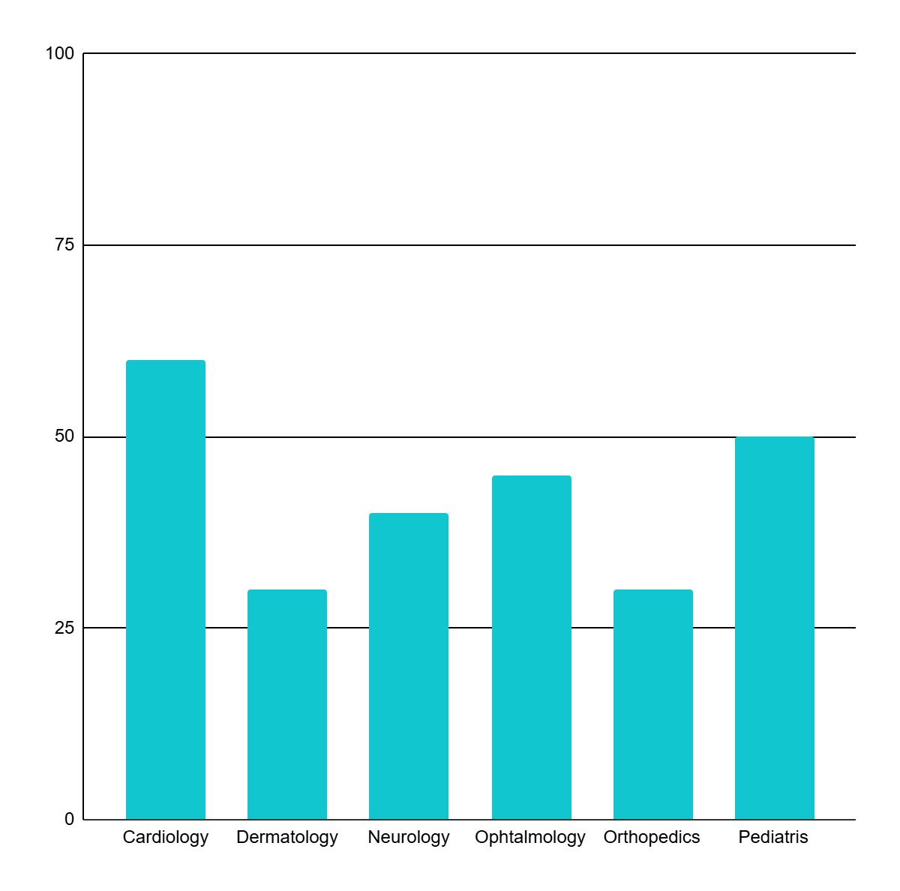
Healthcare infographics
Patient experience
Patients feedback
Patients satisfaction
Average visit
40%
60%
Male
Female
Follow the link in the graph to modify its data and then paste the new one here. For more info, click here
This template has been created by Slidesgo

Slide 5
Healthcare infographics
Checklist
Vaccinations
Check-ups
Healthy diet
Activity
Screenings
Against infectious diseases
Early detection and monitoring
Nutrition for long-term health
Movement for body and mind
Preventive medical tests
This template has been created by Slidesgo

Slide 6
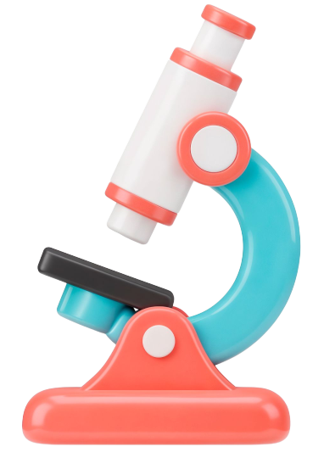
Healthcare infographics
History
Examination
Jupiter is a huge gas giant and the biggest planet of them all
Mercury is the closest planet to the Sun and the smallest one
Evaluation
Tests
Earth is the third planet from the Sun and harbors human life
Venus is the second planet from the Sun and is very hot
This template has been created by Slidesgo

Slide 7
Healthcare infographics
Surgeons
Earth is the third planet from the Sun and harbors human life
Anesthetists
Jupiter is a huge gas giant and the biggest planet of them all
This template has been created by Slidesgo

Slide 8

Healthcare infographics
Infection control in healthcare
Mercury is the smallest planet
1
Hand hygiene
Venus has a beautiful name
Earth is the planet with life
2
PPE
Mars was named after a god
Jupiter is a huge gas giant
3
Sterilization
Saturn has beautiful rings
Neptune is far away from us
4
Isolation
Pluto is now a dwarf planet
This template has been created by Slidesgo

Slide 9
Healthcare infographics
This is primary care
Heart rate
Jupiter is a
gas giant
Primary care is the first point of contact in the healthcare system
Blood press.
Earth is the planet with life
Temperature
Venus has a toxic atmosphere
This is specialized care
Specialized care provides treatment by medical specialists
Oxygen
Mars is full of iron oxide dust
This is emergency care
Emergency care treats urgent and life-threatening conditions
Jupiter is very big
We all live
on Earth
Venus is
very hot
Mars is a
cold planet
This template has been created by Slidesgo

Slide 10
Healthcare infographics
Every 12 months
Preventive visits help detect health issues early
Regular check-ups
14%
30%
60%
Every few years
Vaccines protect against infectious diseases
Vaccination schedule
Earth is the third planet from the Sun
Despite being red, Mars is cold
Venus has a beautiful name
Long-term care
Ongoing monitoring improves patient outcomes
Chronic care
Conclusion
Mercury is the closest planet to the Sun and the smallest one in the Solar System. This planet’s name has nothing to do with the liquid metal,
since Mercury was named after the Roman messenger god. Its surface is quite similar to that of Earth’s Moon
This template has been created by Slidesgo

Slide 11
Healthcare infographics
Healthcare safety
Proper hand hygiene
Follow infection prevention
1
Clean hands before and after patient contact
Use soap and water or alcohol-based sanitizer
3
Clean and disinfect surfaces and equipment
Follow clinical safety guidelines
PPE
Necessary insulation
2
Wear gloves, masks, gowns, or eye protection
Choose PPE based on risk level
4
Isolate patients with contagious conditions
Apply contact, droplet, or airborne precautions
This template has been created by Slidesgo

